Slide 1
Advanced Modeling for Distribution Planning with OpenDSS
Instructor
Roger C. Dugan Sr. Technical Executive Sacramento, California June 22-23, 2017

Slide 2

Instructor
Roger C. Dugan, Life Fellow, IEEE
Roger is a Sr. Technical Executive with EPRI in Knoxville, Tennessee USA. He has over 45 years of combined experience in distribution engineering with EPRI, Electrotek Concepts, and Cooper Power Systems. He holds the BSEE degree from Ohio University and the Master of Engineering in Electric Power Engineering degree from Rensselaer Polytechnic Institute, Troy, NY. Roger has worked on many diverse aspects of power engineering over his career because of his interests in applying computer methods to power system simulation. Beginning with a student internship with Columbus and Southern Ohio Electric Co, his work has been focused on Distribution Engineering. He was elected a Fellow of the IEEE for his contributions in harmonics and transients analysis. Recently, he has been very active in distributed generation, particularly as it applies to utility distribution systems and distribution system analysis. He was the 2005 recipient of the IEEE Excellence in Distribution Engineering Award. He is coauthor of Electrical Power Systems Quality published by McGraw-Hill, now in its 3rd edition. He serves on the IEEE PES Distribution System Analysis Subcommittee and is active in the Distribution Test Feeders WG.

Slide 3
Scripting Basics – Simple Circuit

Slide 4
Scripting
OpenDSS is a scriptable solution engine
Scripts
Series of commands
From text files
From edit forms in OpenDSS.EXE
From another program through COM interface
e. g., This is how you would do looping
Scripts define circuits
Scripts control solution of circuits
Scripts specify output, etc.

Slide 5
Command Syntax
Command parm1, parm2 parm3 parm 4 ….
Parameters may be positional or named (tagged).
If named, an "=" sign is expected.
Name=value (this is the named form)
Value (value alone in positional form)
For example, the following two commands are equivalent:
New Object="Line.First Line" Bus1=b1240 Bus2=32 LineCode=336ACSR, …
New “Line.First Line”, b1240 32 336ACSR, …
Comma or white space

Slide 6
Delimiters
Array or string delimiter pairs: [ ] , { },( ),“ “,‘ ‘
Matrix row delimiter: |
Value delimiters: , (comma) any white space (tab or space)
Class, Object, Bus, or Node delimiter: . (period)
Keyword / value separator: =
Continuation of previous line: ~ (More)
Comment line: //
In-line comment: !
Query a property: ?

Slide 7
Array and Matrix Parameters
Array
kvs = [115, 6.6, 22]
kvas=[20000 16000 16000]
Matrix
(3x3 matrix)
Xmatrix=[1.2 .3 .3 | .3 1.2 3 | .3 .3 1.2]
(3x3 matrix – lower triangle)
Xmatrix=[ 1.2 | .3 1.2 | .3 .3 1.2 ]

Slide 8
A Simple Example

Slide 9
A Basic Script (Class Exercise)
Clear
New Circuit.Simple ! Creates voltage source (Vsource.Source)
Edit Vsource.Source BasekV=115 pu=1.05 ISC3=3000 ISC1=2500 !Define source V and Z
New Transformer.TR1 Buses=[SourceBus, Sub_Bus] Conns=[Delta Wye] kVs= [115 12.47]
~ kVAs=[20000 20000] XHL=10
New Linecode.336ACSR R1=0.058 X1=.1206 R0=.1784 X0=.4047 C1=3.4 C0=1.6 Units=kft
New Line.LINE1 Bus1=Sub_Bus Bus2=LoadBus Linecode=336ACSR Length=1 Units=Mi
New Load.LOAD1 Bus1=LoadBus kV=12.47 kW=1000 PF=.95
Solve
Show Voltages LN Nodes
Show Currents Element
Show Powers kVA Elements

Slide 10
Circuit
New Circuit.Simple ! (Vsource.Source is active circuit element)
Edit Vsource.Source BasekV=115 pu=1.05 ISC3=3000 ISC1=2500
Vsource.Source
SourceBus
Source
115
kV
Short Circuit Impedance (a matrix) that yields 3000A 3-ph fault current and 2500A 1-ph fault current.
115 kV, 1.05 pu
One-Line Diagram (default is 3-phase wye-grd source)

Slide 11
Vsource Element Note
Vsource is actually a Two-terminal Device
2nd terminal defaults to connected to ground (0V)
But you can connect it between any two buses
Comes in handy sometimes
Conceptually a Thevinen equivalent
Short circuit equivalent
Actually converted to a Norton equivalent internally

Slide 12
20 MVA Substation Transformer
SourceBus
TR
1
Sub_Bus
Defining Using Arrays
Defining Winding by Winding
New Transformer.TR1 Phases=3 Windings=2
~ Buses=[SourceBus, Sub_Bus]
~ Conns=[Delta Wye]
~ kVs= [115 12.47]
~ kVAs=[20000 20000]
~ XHL=10
New Transformer.TR1 Phases=3 Windings=2 XHL=10
~ wdg=1 bus=SourceBus Conn=Delta kV=115 kVA=20000
~ wdg=2 bus= Sub_Bus Conn=wye kV=12.47 kVA=20000

Slide 13
The Line
Sub_Bus
LoadBus
LINE
1
1
Mile
,
336
New Linecode.336ACSR R1=0.058 X1=.1206 R0=.1784 X0=.4047 C1=3.4 C0=1.6 Units=kft
New Line.LINE1 Bus1=Sub_Bus Bus2=LoadBus Linecode=336ACSR Length=1 Units=Mi
Line objects may also be defined by Geometry or matrix properties.
(Rmatrix=… Xmatrix=… Cmatrix=…)

Slide 14
The Load
Loadbus
LOAD
1
1000
kW
0
.
95
PF
New Load.LOAD1 Bus1=LoadBus kV=12.47 kW=1000 PF=.95
For 3-phase loads, use L-L kV and total kW
For 1-phase loads, typically use L-N kV and total kW unless L-L-connected; Then use L-L kV.

Slide 15
Solving and Showing Results Reports
Solve
Show summary (power flow summary)
Show Voltages LN Nodes
Show Currents Element
Show Powers kVA Elements
Also
Export … (creates CSV files)
Plot …

Slide 16
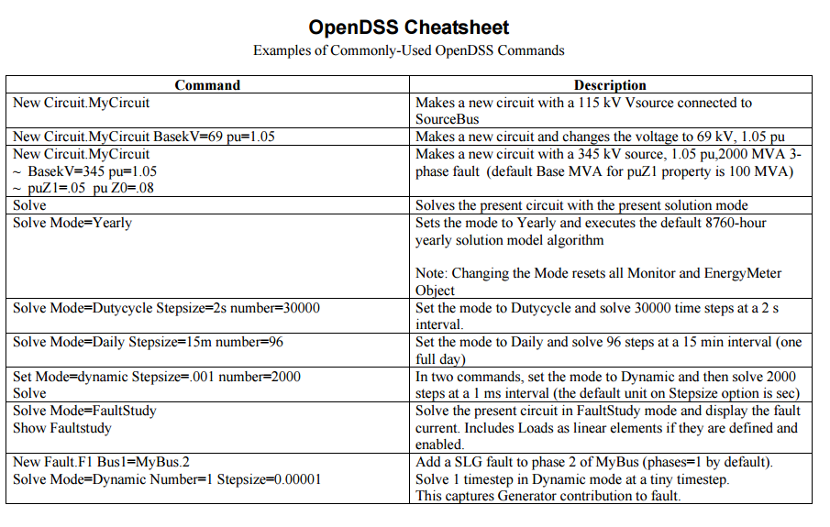
Refer to “OpenDSS Cheatsheet.PDF” in Doc Folder

Slide 17
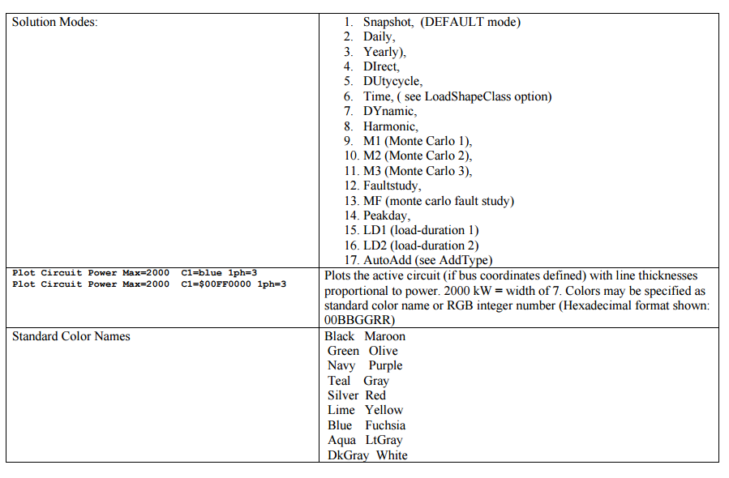
“OpenDSS Cheatsheet.PDF” continued

Slide 18
Add a 500-kW Generator Object to LoadBus
DG
… (continue from existing Script)
New Generator.DG1 Bus1=LoadBus kV=12.47 kW=500 PF=1.0
// solve again and observe results
Solve ! Starts with previous solution
Show Voltages LN Nodes
Show Currents Element
Show Powers kVA Elements

